Slide 1















Ubuntu
VUE
Quasar
Spring Boot
Jira Software
MyBatis

Slide 2
System Architecture
Front
Vue.js
..
..
..
DTO
REST API SERVICE
DTO
Amazon EC2
REST Controller
SERVICE
DAO
DTO
MySQL

Slide 3
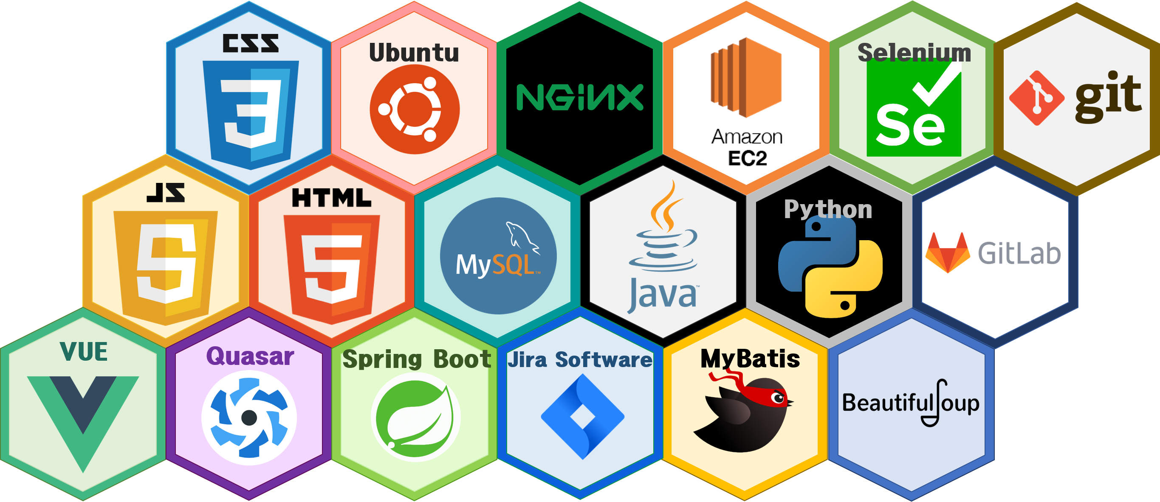


Ubuntu
VUE
Quasar
Spring Boot
Jira Software
MyBatis

